Slide 1

DSpace: An Open Source Repository for Academic Libraries and Other Institutions
Terry Brady
Seattle Java Users Group
November 2015

Slide 2
My Background - Highlights
https://github.com/terrywbrady/info
LexisNexis
Developed data conversion, metadata management, and legal publishing systems
Developing in Java since 1998
Developed case management and reporting applications for DC non-profits
National Archives and Records Administration
Developed tools to support the digitization of the 1940 Census and other digitization projects
NARA released 2 of my applications on GitHub
Georgetown University Library
Customize open source and commercial library applications
Support DigitalGeorgetown - our instance of DSpace
New committer to the DSpace project
Relocated to Seattle in 2014 - Telecommute

Slide 3
What is DSpace
Institutional Repository Platform
Designed to address the concerns of universities and institutions
http://registry.duraspace.org/registry/dspace
Approximately 2000 instances around the world

Slide 4
Overview
Unique software needs of libraries/archives/cultural heritage institutions
What is an institutional repository
History of DSpace
Standards implemented by DSpace
Overview of DSpace and the DSpace community
Architecture/Evolution of the platform from release to release
The current search for a new (modern) UI framework

Slide 5
Commercial Software in a Library
Library Catalog
Subscription Management/Link Resolver
After searching an academic journal, indicate accessible resources
Discovery Services
Search catalog
All known journals
Commercial databases

Slide 6
Unique Software Needs of Libraries and Archives
Open access to information
Free and accessible
Wary of vendor lock-in
Information sustainability
License costs
Information sharing
Consortial agreements
Support for open data standards
Information preservation
Long-term accessibility (decades)
Analog Media accessibility
Digital Media format accessibility
Bit preservation over the long term
Citation of information
Link rot

Slide 7
Other attributes of libraries and archives
Non-profit - limited IT budgets
Information science
Favor open standards / open access to information
Reflective: publish articles on institutional operations
Strong mission
High level ideals for information management (pro/con)
Necessary to collaborate

Slide 8
What is an institutional repository?

Slide 9
What is an institutional repository?
Open source repository
Showcase unique scholarship and assets of an institution
Provide open access to content
Built on an open source platform
Supports several data sharing standards

Slide 10
Unique Scholarship/Assets of an Institution
Faculty Papers
Theses, dissertations
Student journals and publications
Digitized Content
Archives, Manuscripts, Rare Books, Art Collections
Institution publications such as newspapers, magazines, yearbooks,
Online course material
Conference proceedings
Much of this information does not exist elsewhere
Or it would live in an ad-hoc, uncontrolled location (personal website)

Slide 11
DigitalGeorgetown - Institutional Repository Example
https://repository.library.georgetown.edu/
Browse the “Institutional Repository”
Explore Digital Collections
Explore photo collections
Student newspapers
Rare books (book view)
Videos
Online course content
Mobile site
Screen Shots from the live demo are on the following slides

Slide 12
DigitalGeorgetown
An example of an institutional repository
https://repository.library.georgetown.edu

Slide 13
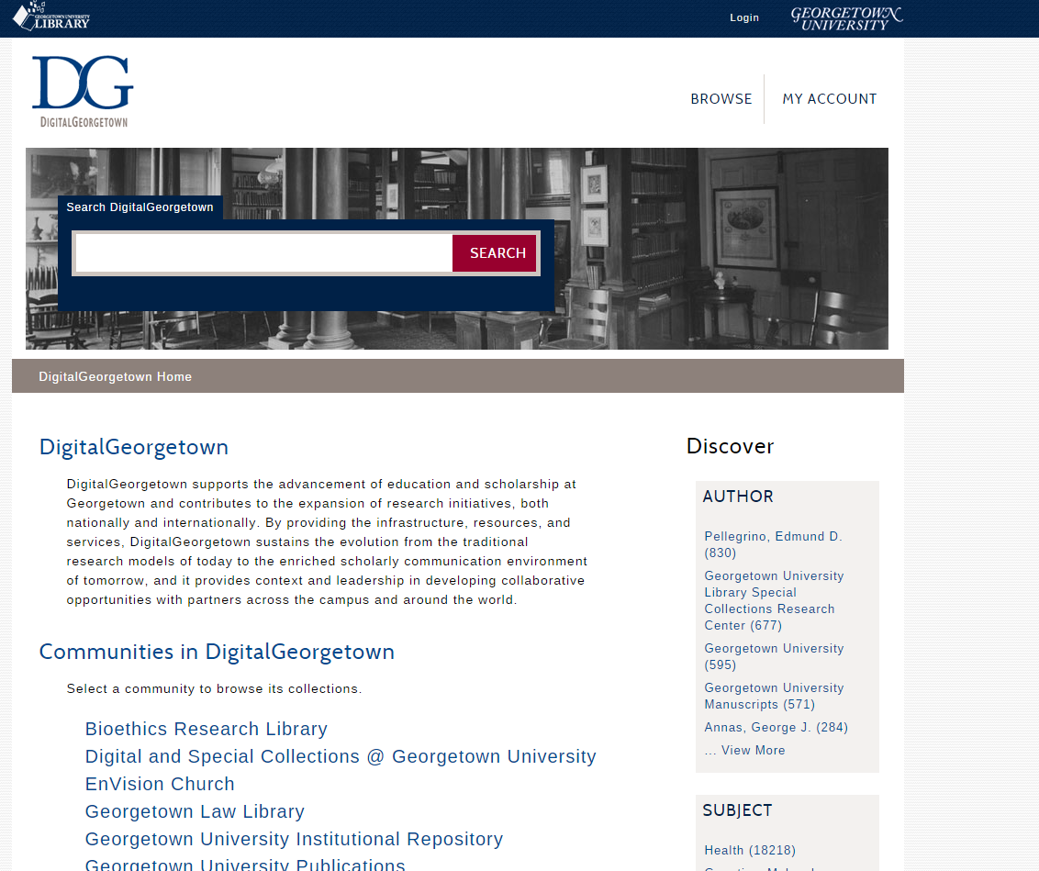
Repository
Hierarchy

Slide 14
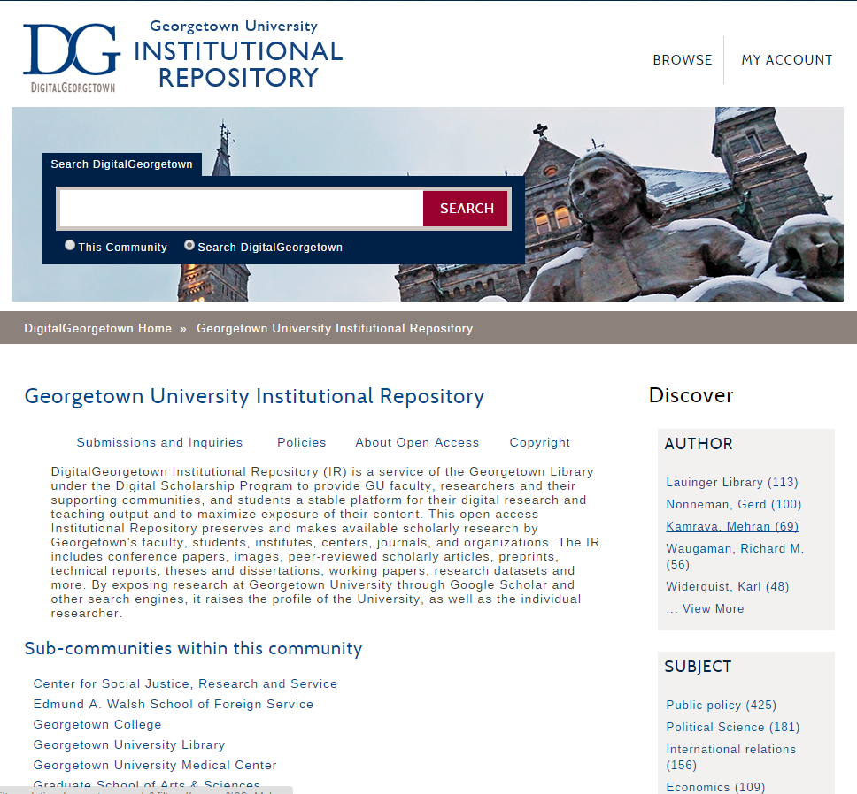
Institutional
Repository
By College

Slide 15
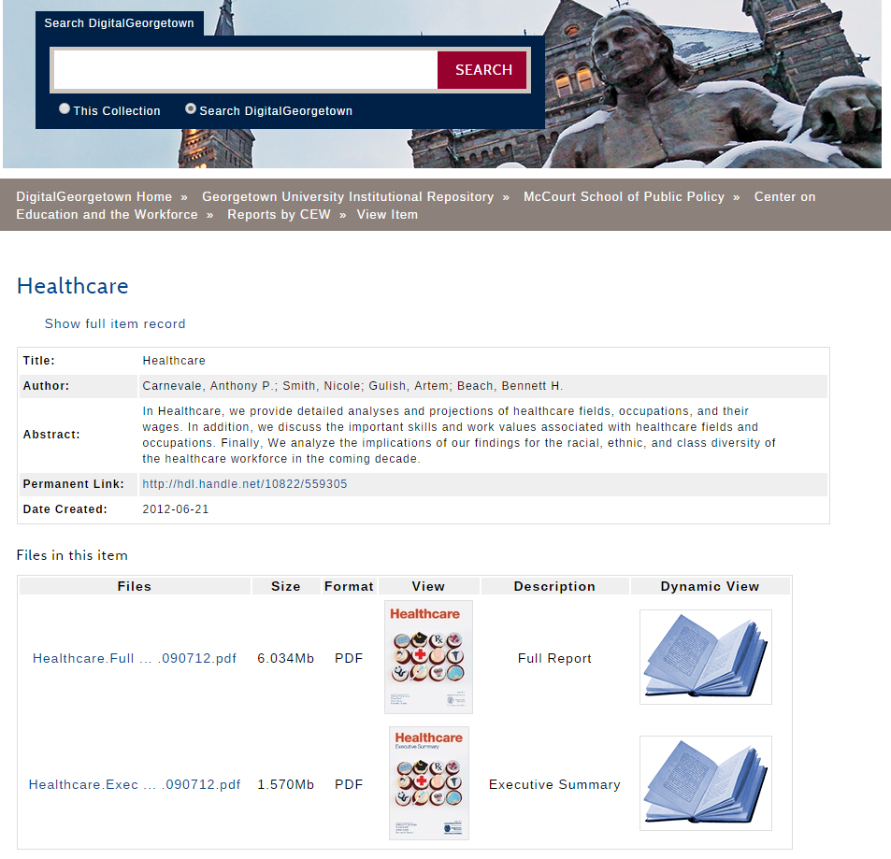
Item Page in the Institutional Repository

Slide 16
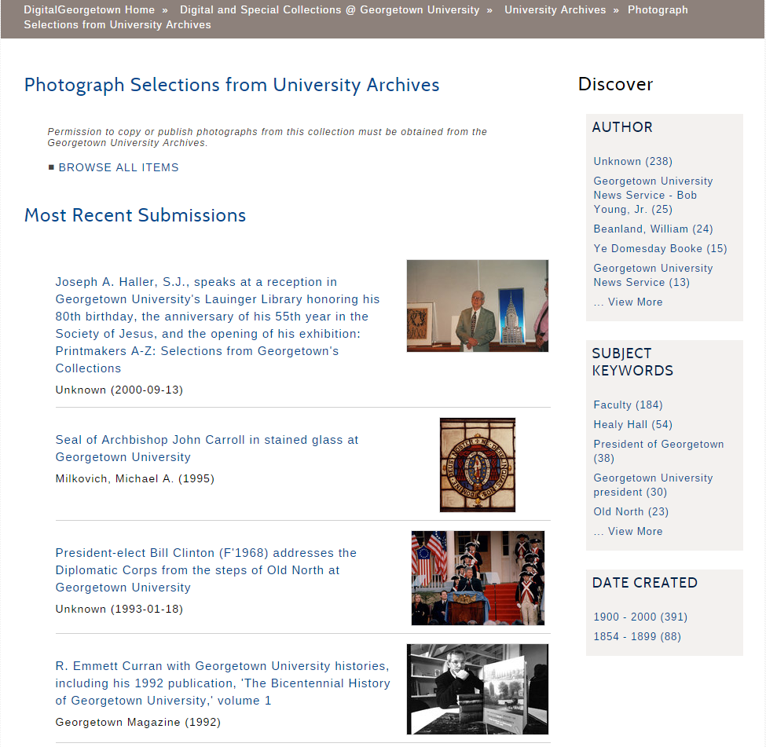
Digitized Photos

Slide 17
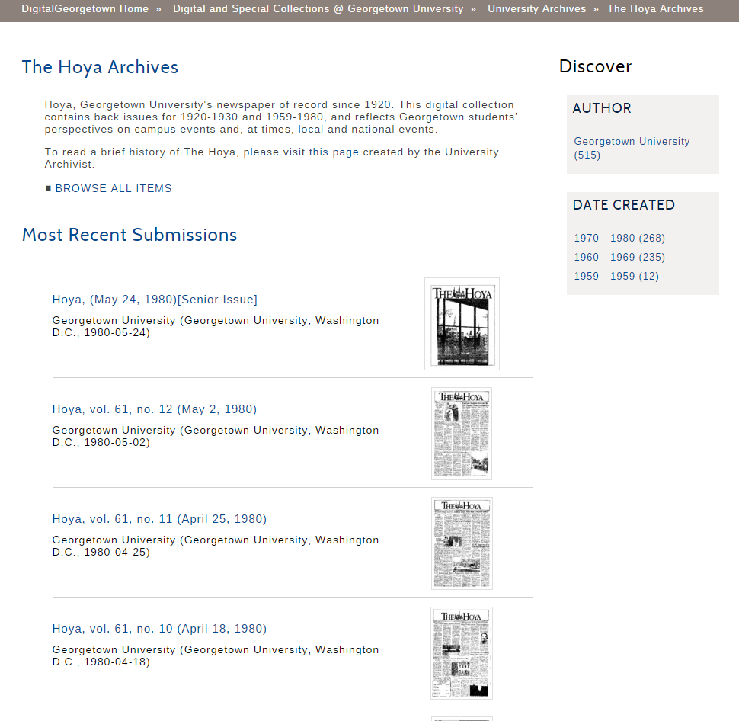
Digitized
Student Newspaper

Slide 18
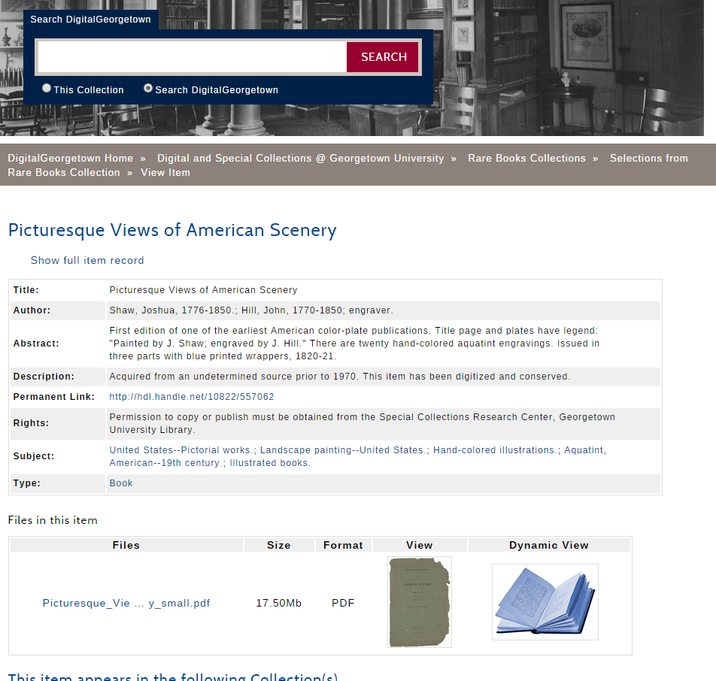
Rare Book Item Page

Slide 19
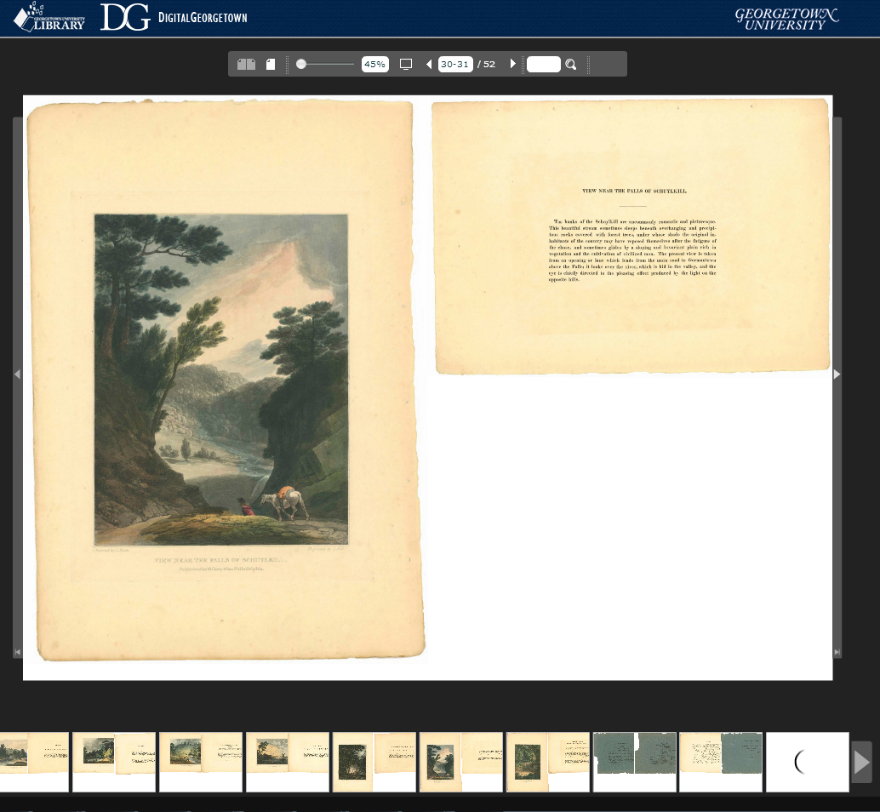
Book
Viewer

Slide 20
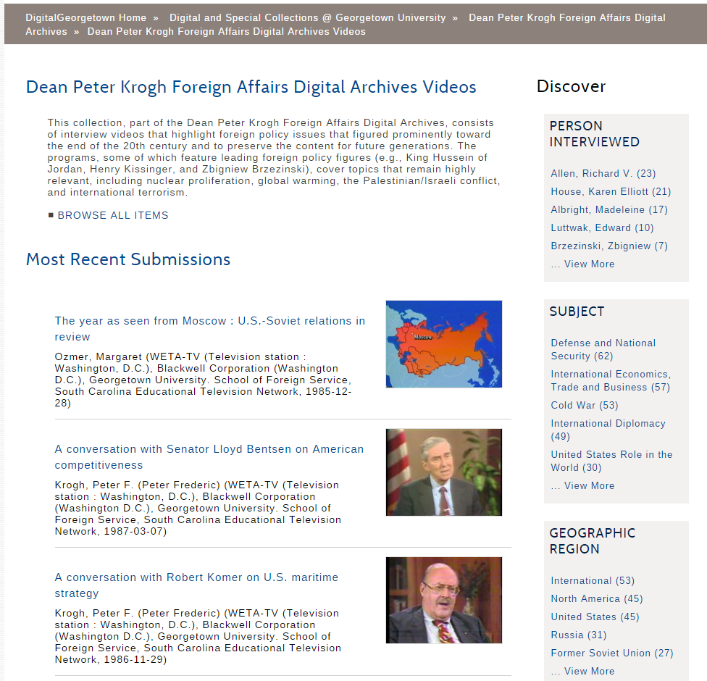
Digitized Video Collection

Slide 21
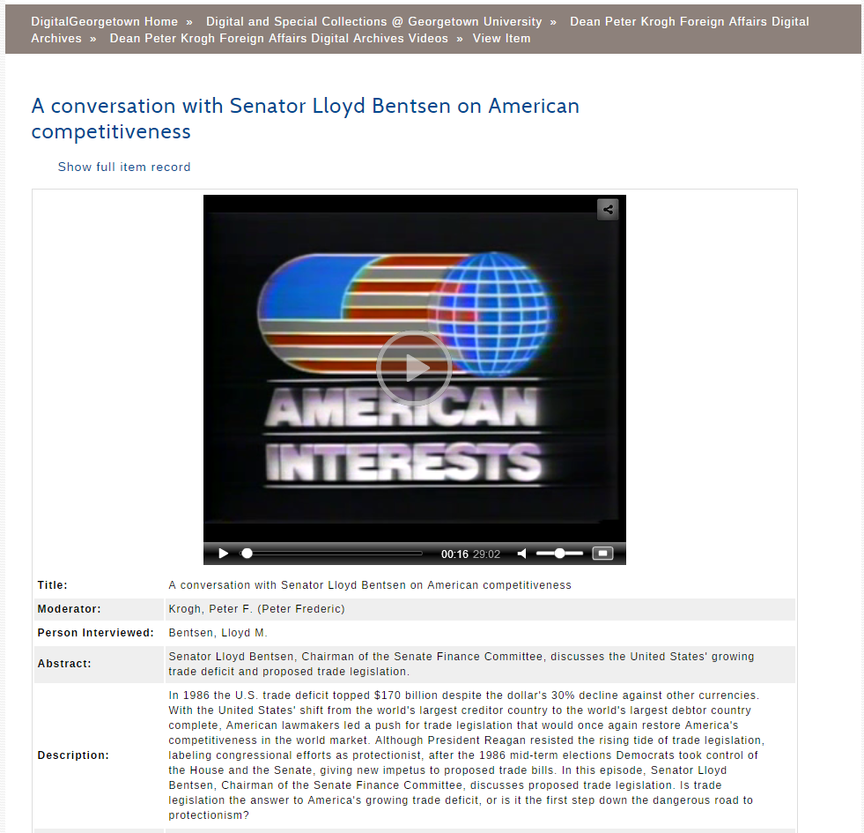
Video Player

Slide 22
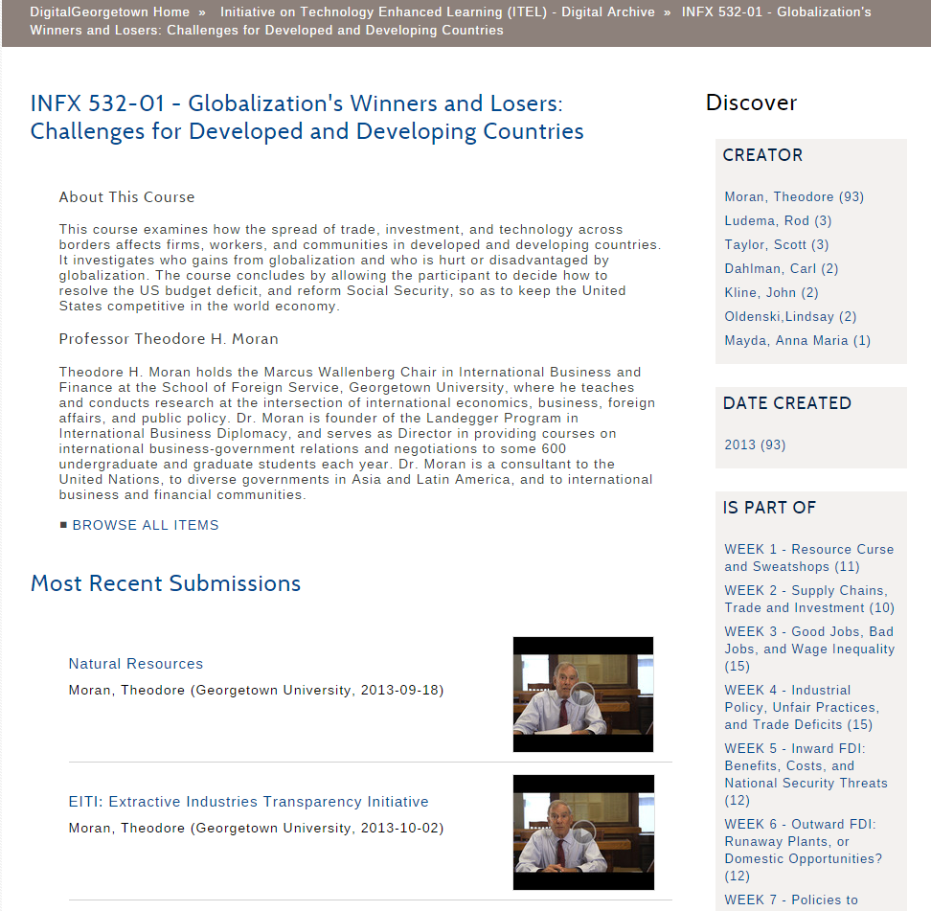
MOOC (Online Course) Content

Slide 23
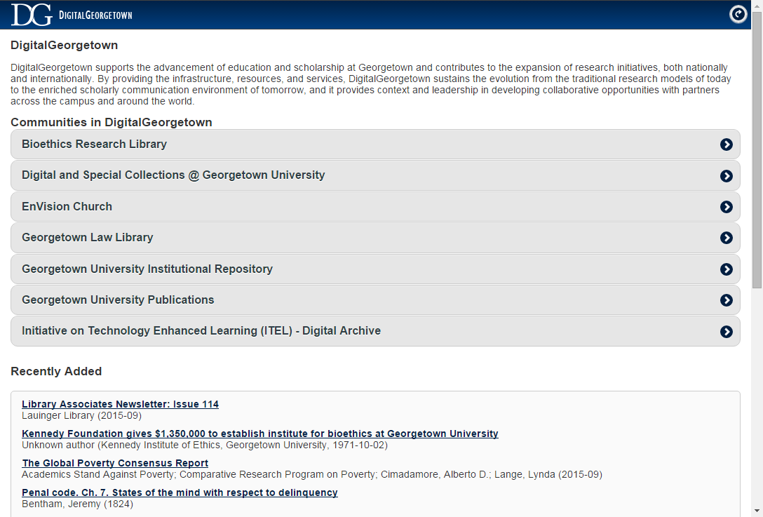
Mobile Website

Slide 24
What Data Standards are implemented by an Open Repository?

Slide 25
Data Standards Implemented by Open Repositories
Open Archival Information System - OAIS
Metadata Standards
Harvesting Standards
Handle Service

Slide 26
Open Archival Information System - OAIS
Theoretical framework for how an archival system should behave
Archival Information Package
Repository
Submission Information Package
Dissemination
Information Package

Slide 27
Full resolution original
Media optimized for access
Descriptive metadata
Proprietary metadata
Archival Information Package
Repository
Submission Information Package
Dissemination
Information Package

Slide 28
Optimized for long term storage
Check bit level preservation
Some institutions participate in a preservation repository to ensure long term (decades) accessibility of information
Archival Information Package
Repository
Submission Information Package
Dissemination
Information Package

Slide 29
Media optimized for access
Descriptive metadata
Archival Information Package
Repository
Submission Information Package
Dissemination
Information Package

Slide 30
Metadata Standards
Facilitates interchange between different systems
Examples
Dublin Core: Defines “title”, “author”, “date created”, etc
METS: Hierarchical relationships between objects
Classify metadata
descriptive - intellectual description of the object
technical - specifications/how the media was produced
administrative - what has been done and what can be done to an object

Slide 31
Harvesting Standards
OAI-PMH: Open Archives Initiative Protocol for Metadata Harvesting
Sharing content between repositories
Like RSS
Consortial Partners (geographic or other affiliation)
Useful for interchange with vendors

Slide 32
Handle Service
Provide permanent links to content
Links can persist beyond the life of a repository or repository implementation
Valid for bibliographic citations
hdl.net service
Institutions pay a membership fee
Institution is allocated a handle prefix
Repository assigns full handle
Permanent links point to hdl.net
Links resolve back to repository

Slide 33
Other Standards
SWORD - Simple Web-service Offering Repository Deposit
DOI - Digital Object Identifier (for citations)
ORCID - Open Researcher and Contributor ID
Sherpa/Romeo - Standards around publishing policies for academic journals
RDF - Resource Description Framework
Schema.org - Semantic markup to facilitate discovery

Slide 34
What Institutional Repository Platforms Exist?

Slide 35
Institutional Repository Platforms
Most common platforms
DSpace
Fedora
EPrints
Participating institutions
May pay membership fees
May be on the governing board for the project
Commit developer/testing resources
Open Repositories Conference
Annual conference
Alternates annually between Europe and North America

Slide 36
DSpace History*
2002 - MIT and HP Labs
2004 - Committer group established
2007 - DSpace Foundation created to oversee the project
2009 - DuraSpace - nonprofit overseeing both DSpace and Fedora
Institutional membership fees
Offer hosted solutions and storage solutions
Provide limited FTE support to projects (product management, technical leadership)
*https://en.wikipedia.org/wiki/DSpace

Slide 37
DSpace Adoption*
Approximate 2000 instances
Global Usage
Primarily in North America, Europe, Asia
Annual releases
Release Team from Committers
DSpace Community
24 committers
~60 code contributors
22 community advisory team members
institutional members/governance
~1 FTE from DuraSpace to coordinate the project
Thanks to Tim Donohue from DuraSpace for providing links to these resources
http://www.slideshare.net/duraspace/
http://www.slideshare.net/tdonohue/

Slide 38
What is the DSpace Architecture?

Slide 39
Repository Components
Asset Store
(File System or Cloud Storage)
Webapps
Database
Webapps
Webapps
Search Index
(SOLR)
Statistics Index
(SOLR)
Harvester
Index
(SOLR)

Slide 40
Repository Hierarchy
Asset Store
(File System or Cloud Storage)
Webapps
Database
Community and Collection Hierarchy
Webapps
Webapps
Search Index
(SOLR)
Statistics Index
(SOLR)
Harvester
Index
(SOLR)

Slide 41
Submit an Item to the Repo
Asset Store
(File System or Cloud Storage)
Webapps
Database
Submission Ingest Package
Webapps
Metadata about the item
Media File
(PDF, Image, etc)
Webapps
Search Index
(SOLR)
Statistics Index
(SOLR)
Harvester
Index
(SOLR)

Slide 42
Item Metadata Saved to Database
Asset Store
(File System or Cloud Storage)
Webapps
Database
Metadata about the item
Submission Ingest Package
Webapps
Media File
(PDF, Image, etc)
Metadata about the item
Webapps
Search Index
(SOLR)
Statistics Index
(SOLR)
Harvester
Index
(SOLR)

Slide 43
Item Media Saved to Asset Store
Asset Store
(File System or Cloud Storage)
Webapps
Database
Media File
(PDF, Image, etc)
Metadata about the item
Submission Ingest Package
Webapps
Media File
(PDF, Image, etc)
Webapps
Search Index
(SOLR)
Statistics Index
(SOLR)
Harvester
Index
(SOLR)

Slide 44
Metadata added to Search Index
Asset Store
(File System or Cloud Storage)
Webapps
Database
Media File
(PDF, Image, etc)
Metadata about the item
Webapps
Webapps
Search Index
(SOLR)
Statistics Index
(SOLR)
Harvester
Index
(SOLR)
Metadata about the item

Slide 45
Media File Processing
Asset Store
(File System or Cloud Storage)
Webapps
Database
Text Extract
Media File
(PDF, Image, etc)
Thumbnail
Metadata about the item
Webapps
Webapps
Search Index
(SOLR)
Statistics Index
(SOLR)
Harvester
Index
(SOLR)
Metadata about the item

Slide 46
Add Full Text to Search Index
Asset Store
(File System or Cloud Storage)
Webapps
Database
Text Extract
Media File
(PDF, Image, etc)
Thumbnail
Metadata about the item
Webapps
Webapps
Search Index
(SOLR)
Statistics Index
(SOLR)
Harvester
Index
(SOLR)
Text Extract
Metadata about the item

Slide 47
Add Metadata to Harvester Index
Asset Store
(File System or Cloud Storage)
Webapps
Database
Text Extract
Media File
(PDF, Image, etc)
Thumbnail
Metadata about the item
Webapps
Webapps
Search Index
(SOLR)
Statistics Index
(SOLR)
Harvester
Index
(SOLR)
Text Extract
Metadata about the item
Metadata about the item

Slide 48
Search/browse via webapps
Asset Store
(File System or Cloud Storage)
Webapps
Database
Webapps
Webapps
Search Index
(SOLR)
Statistics Index
(SOLR)
Harvester
Index
(SOLR)

Slide 49
DSpace Interfaces
Webapps
Webapps
Webapps
http://demo.dspace.org/

Slide 50
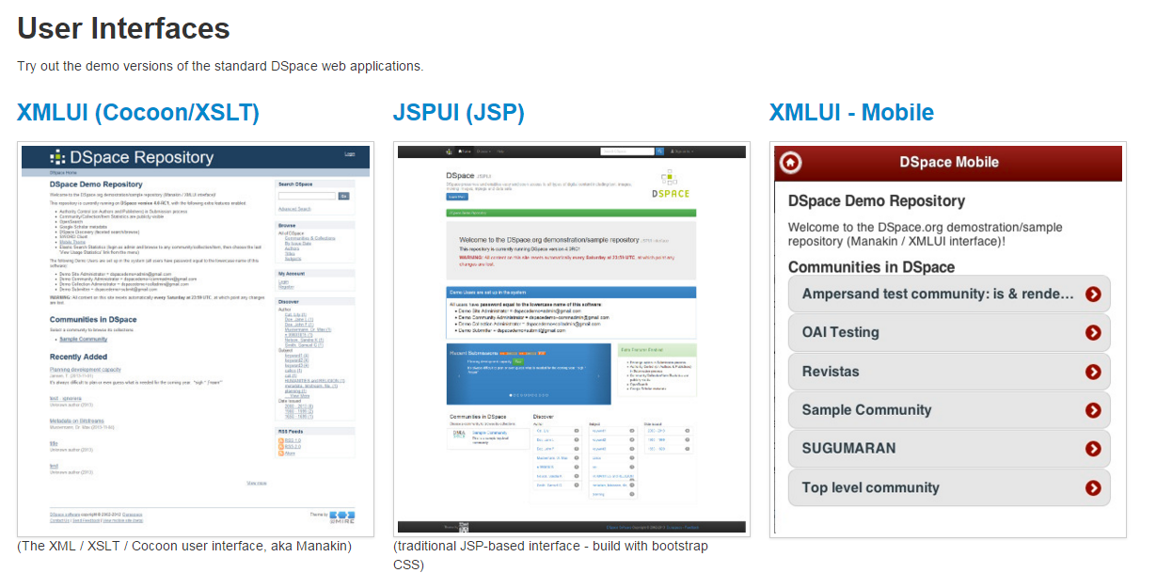
http://demo.dspace.org

Slide 51
XMLUI (46% of DSpace Instances)
Built on Apache Cocoon
XML Processing pipeline using Java and XSLT
Nearly obsolete
60% of instances are up to date
7 yrs old
responsive theme since v5
12/23 committers use XMLUI
North America | 33%
Europe | 29%
Asia | 18%
South America | 11%
Africa | 6%
Oceana | 3%
http://www.slideshare.net/tdonohue/

Slide 52
JSPUI (54% of DSpace Instances)
only 30% of instances are up to date
12 yrs old
responsive theme since v4
7/23 committers use JSPUI
Asia | 35%
Europe | 33%
South America | 15%
North America | 12%
Africa | 3%
Oceana | 2%
http://www.slideshare.net/tdonohue/

Slide 53
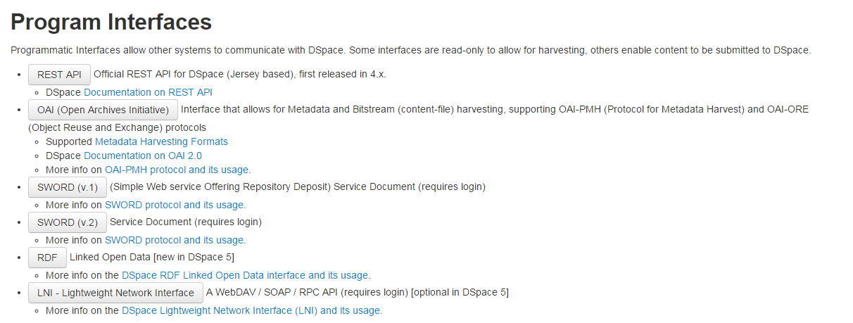
Webapps
Webapps
Webapps
http://demo.dspace.org

Slide 54
Webapps
Webapps
REST
Jersey-based REST API
OAI-PMH
Harvesting Interface
SWORD (V1 and V2)
Deposit interface from another application
RDF
Publish repository content as RDF
LNI
Lightweight Network Interface
Webapps
Webapps

Slide 55
DSpace Architecture
Java Application
Runs in tomcat, supported on Linux, Windows
PostgreSQL or Oracle database for metadata
Asset store for media files
Opaque storage
Cloud storage plugin
3 SOLR indexes
Search, OAI, Statistics
2 Supported User Interfaces
Maintenance challenge
REST API
Authentication plugins (Password, LDAP, Shibboleth, Certificate)
Primitive digital preservation facilities (checksum monitoring)

Slide 56
Community Tools
GitHub
Maven
Travis
Jira
Confluence Wiki
IRC
Meetings alternate 1PM PT/8AM PT to include committers around the world
Mailing lists
StackOverflow

Slide 57
How has the Architecture Evolved?

Slide 58
Version 1.8 - 2011
Asset Store
(File System or Cloud Storage)
XMLUI
JSPUI
Database
Search Index
(Lucene)
Statistics Index
(SOLR)
Search Index
(SOLR)
Optional
https://wiki.duraspace.org/display/DSPACE/Releases

Slide 59
Version 3 - 2012
Asset Store
(File System or Cloud Storage)
XMLUI
JSPUI
Database
Mobile
(optional)
Search Index
(Lucene)
Statistics Index
(SOLR)
Search Index
(SOLR)
Facets, No Authorization
Statistics Index
(Elastic)
Optional
https://wiki.duraspace.org/display/DSPACE/Releases

Slide 60
Version 4 - 2013
Asset Store
(File System or Cloud Storage)
XMLUI
JSPUI
Responsive theme
Database
Mobile
Search Index
(Lucene)
Optional
Statistics Index
(SOLR)
REST
No Authorization
Search Index
(SOLR)
Authorization Aware
Statistics Index
(Elastic)
Optional
OAI- PMH Index
(SOLR)
https://wiki.duraspace.org/display/DSPACE/Releases

Slide 61
Version 5 - 2015
Asset Store
(File System or Cloud Storage)
XMLUI
Responsive theme
JSPUI
Responsive theme
Database
Mobile
RDF
Search Index
(Lucene)
Optional
Statistics Index
(SOLR)
REST
with read/write
Search Index
(SOLR)
Statistics Index
(Elastic)
Optional
OAI- PMH Index
(SOLR)
https://wiki.duraspace.org/display/DSPACE/Releases

Slide 62
Version 6 - 2016
Asset Store
(File System or Cloud Storage)
XMLUI
Responsive theme
JSPUI
Responsive theme
Database
via Hibernate
Mobile
RDF
Search Index
(Lucene)
Optional
Statistics Index
(SOLR)
REST
Search Index
(SOLR)
Statistics Index
(Elastic)
Optional
OAI- PMH Index
(SOLR)
https://wiki.duraspace.org/display/DSPACE/Releases

Slide 63
Version 7 - 2017?
Asset Store
(File System or Cloud Storage)
XMLUI
Responsive theme
JSPUI
Responsive theme
Database
via Hibernate
Mobile
REST
Search Index
(SOLR)
Statistics Index
(SOLR)
REST
Modern UI Platform
Statistics Index
(Elastic)
Optional
OAI- PMH Index
(SOLR)
https://wiki.duraspace.org/display/DSPACE/Releases

Slide 64
Beyond V7
Simplified Development - One UI
Directed development (aligned with a technical roadmap)
Create a Plugin framework

Slide 65
Community Challenges
Limited volunteer bandwidth
2 UI’s - Dual maintenance
Many institutions have no developer resources or very limited resources
Apache Cocoon and JSP are not attractive technologies
UI Customization is the most common enhancement
Will institutions migrate to a new UI platform?
Directed code contributions
Code contributions need to align with the technical roadmap

Slide 66
UI Prototype Challenge
https://wiki.duraspace.org/display/DSPACE/DSpace+UI+Prototype+Challenge
Must use either the REST API or the Hibernate-based API
Must be open source
No more than 80 hours of work
UI Prototype Challenge
The community will review prototypes and select a new UI framework

Slide 67
UI Prototype Submissions
Spring Boot + Thymeleaf
REST + Ruby on Rails
REST + Play!
REST + Ember.js
Java API + Jersey + Twirl (in Scala)
Spring MVC + Spring tags + Spring security + sitemesh + custom extensions
REST + Spring Boot + Angular.js

Slide 68
What I love about this work
A small about of development can make a big impact
Organizations with limited IT resources
Good cause
Culture of sharing - share by default
Good people, helpful
Interesting to see the operations of an open source project
https://github.com/terrywbrady/info

